Slide 1


Slide 2
Supplement C
Operations Technology

Slide 3
OBJECTIVES
Hardware Systems
Software Systems
Formula for Evaluating Robots
Computer Integrated Manufacturing
Technologies in Services
Benefits
Risks
Notes:
2

Slide 4
Hardware Systems
Numerically controlled (NC) machines
Machining centers
Industrial robots
Automated material handling (AMH) systems
  Automated Storage and Retrieval Systems (AS/AR)
  Automate Guided Vehicle (AGV)
Flexible manufacturing systems (FMS)
Notes:
3

Slide 5
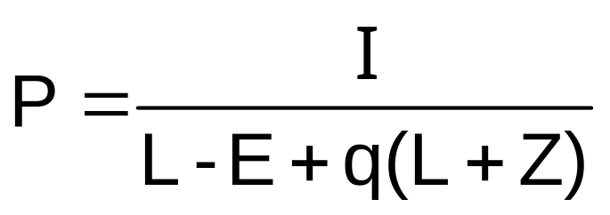
Formula for Evaluating a Robot Investment
The payback formula for an investment in robots is:
Where
P = Payback period in years
I = Total capital investment required in robot and accessories
L = Annual labor costs replaced by the robot (wage and
benefit costs per worker times the number of shifts per day)
E = Annual maintenance cost for the robot
Z = Annual depreciation
q = Fractional speedup (or slowdown) factor (in decimals). Example: If robot produces 150 % of what the normal worker is
capable of doing, the fractional speedup factor is 1.5.
Notes:
3

Slide 6
Example of Evaluating a Robot Investment
Suppose a company wants to buy a robot. The bank wants to know what the payback period is before they will lend them the $120,000 the robot will cost. You have determined that the robot will replace one worker per shift, for a one shift operation. The annual savings per worker is $35,000. The annual maintenance cost for the robot is estimated at $5,000, with an annual depreciation of $12,000. The estimated productivity of the robot over the typical worker is 110%. What is the payback period of this robot?
P = I = 120,000 =1.47years
L–E+q(L + Z) 35,000–5,000+1.1(35,000+12,000)
Notes:
3

Slide 7
Software Systems
Computer-aided-design (CAD)
  Computer-aided engineering (CAE)
  Computer-aided process planning (CAPP)
Automated manufacturing planning and control systems (MP & CS)
Notes:
4

Slide 8
Computer Integrated Manufacturing (CIM)
Product and process design
Planning and control
The manufacturing process
Notes:
5

Slide 9
Cost Reduction Benefits from Adopting New Technologies
Labor costs
Material costs
Inventory costs
Transportation or distribution costs
Quality costs
Other costs
Notes:
7

Slide 10
Other Benefits….
Increased product variety
Improved product features and quality
Shorter cycle times
Notes:
8

Slide 11
Risks
Technological risks
Organizational risks
Environmental risks
Market risks
Notes:
9

Slide 12
End of Supplement C

